Slide 1
Garbage monitoring system
Animation Video

Slide 2

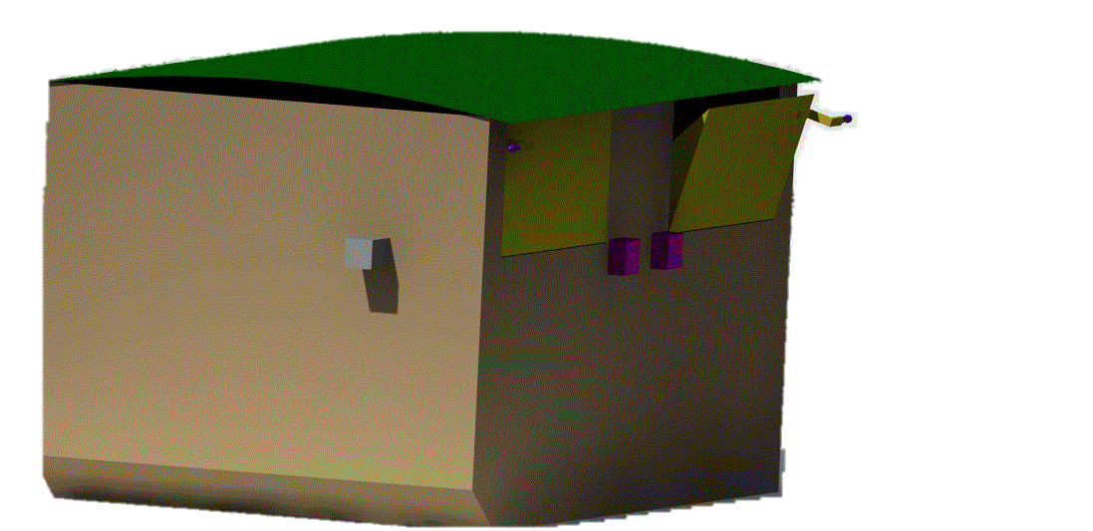

Slide 3


Slide 4


Slide 5


Slide 6


Slide 18
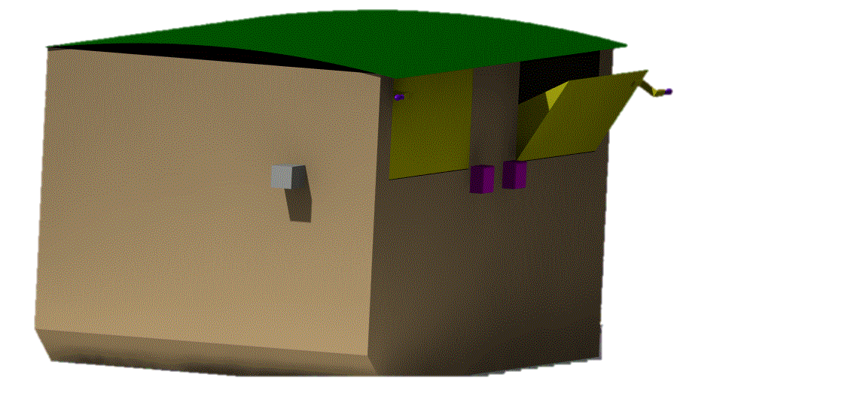
Garbage Bin opens automatically after 2 seconds

Slide 19
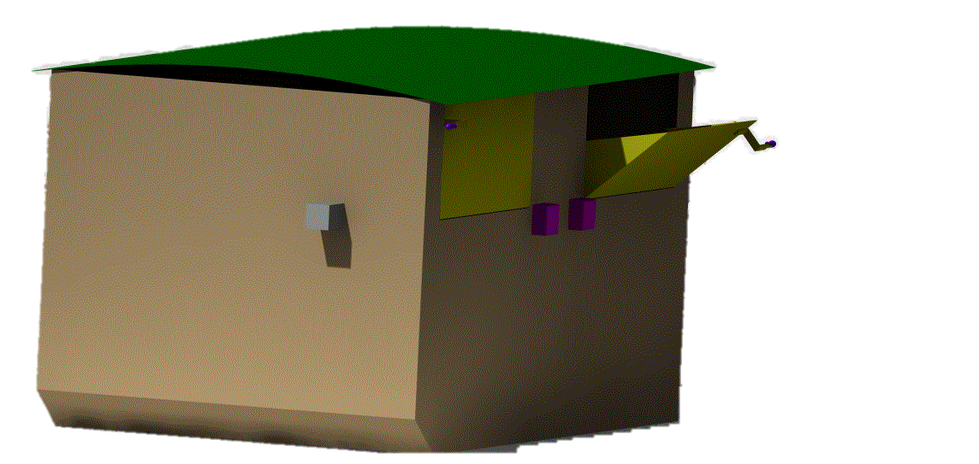
Garbage Bin opens automatically after 2 seconds

Slide 20
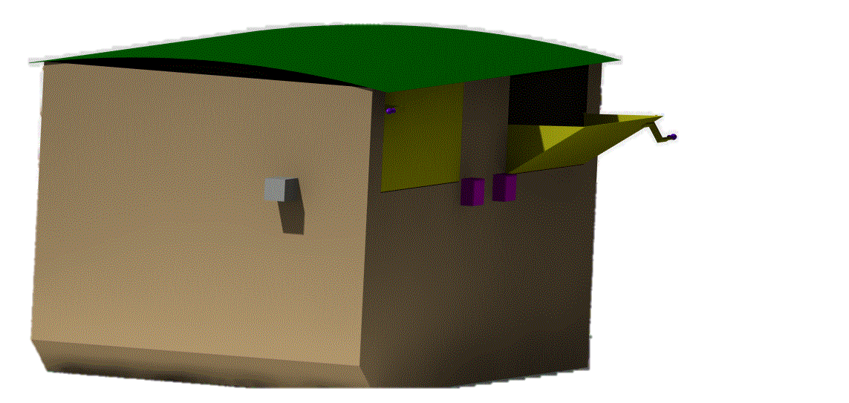
Man throws garbage into the bin and walks away

Slide 21
Garbage Bin closes automatically after garbage is thrown

Slide 22
Garbage Bin closes automatically after garbage is thrown

Slide 23
Garbage Bin closes automatically after garbage is thrown

Slide 24
Garbage Bin closes automatically after garbage is thrown

Slide 25
Sensor present inside Garbage bin sense the condition of overflow

Slide 26
If there are chances of overflow then our system sends Alarm message to Supervisor

Slide 27
SUPERVISOR
System sending message…..

Slide 28
If no action is taken after 1 day , then our system sends message to higher Authority

Slide 29
SUPERVISOR
Higher Authority
System sending message to Higher Authority and Supervisor Both…..

